Slide 1
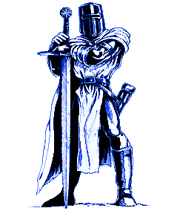
Academies of Discovery at
South Hall

Slide 2
https://www.wevideo.com/view/21015714452nd

Slide 3


Mascot: Knight
School Colors: Columbia Blue, Navy and White
Starting Time: 8:20
Ending Time: 3:15

Slide 4
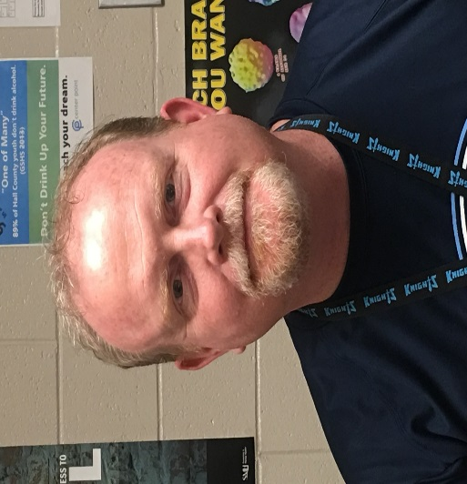
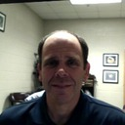
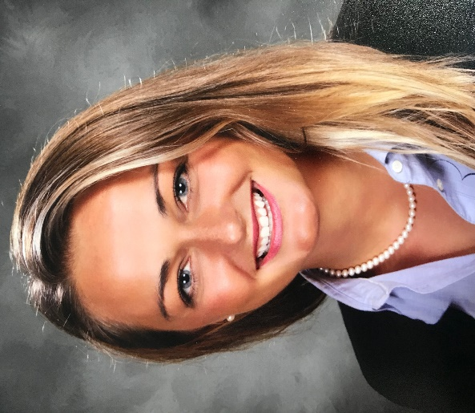
Administrators
Joey Millwood
Kent Townley
Abbie Celli

Slide 5
Registration
Feeder School Students do not need to register
New to Hall County - may register in the summer
Make sure Immunizations are up to date
  Georgia Immunization form 3231

Slide 6

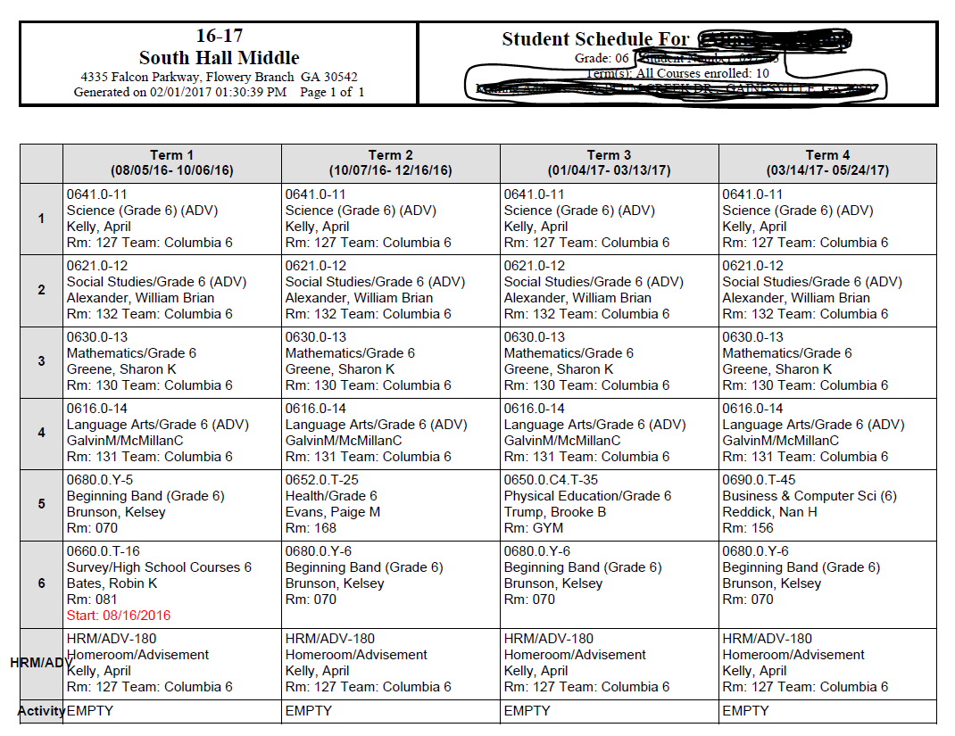
Transition from
Elementary to Middle School
Classes/Academies
Scheduling
Connections
Dress for success
Technology

Slide 7

Renaissance
Synergy
Valor
Da Vinci

Slide 8

Connections Classes
Chorus
Band
Business & Computer Science
Art
Construction
Family & Consumer Science
Health Care Science
Introduction to Spanish
Native Speakers Spanish Introduction
Physical Education and Health
Tech Media
Theatre Arts
https://forms.gle/gViMssogHFd5sZPV9

Slide 9


Slide 10
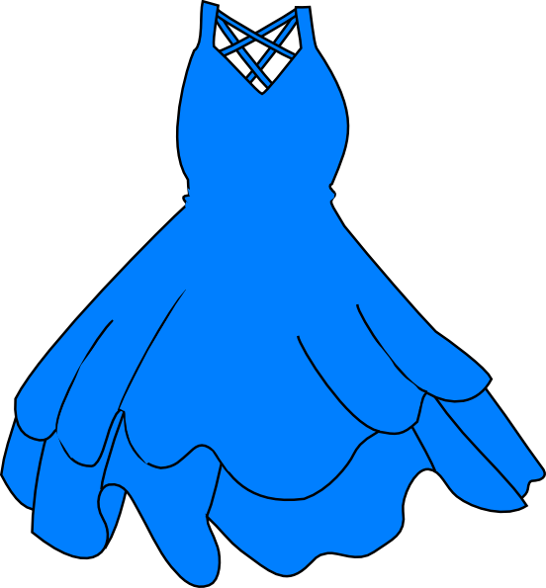
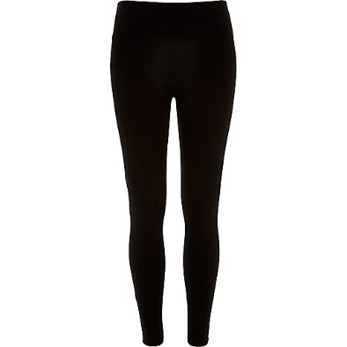
Dress Code
The following items are NOT allowed at A.O.D:
Go
Knights!
Tube top or strapless dresses
Sleeveless tops
Shirts that expose the stomach
Leggings and Jeggings must be worn with shirt or dress within 6 inches from the crease of knee.

Slide 11
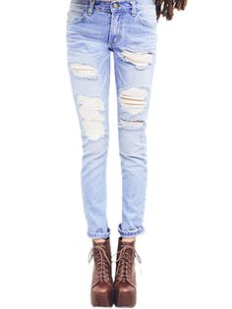
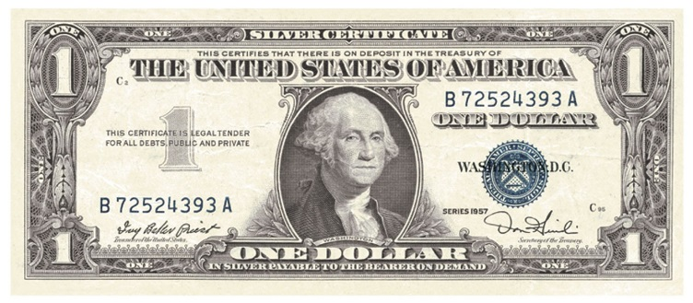
Dress Code
The following items are NOT allowed at A.O.D:
Jeans with holes or frays above the knee
Mini skirt or short shorts
(Dollar Bill Rule)
See through clothing

Slide 12
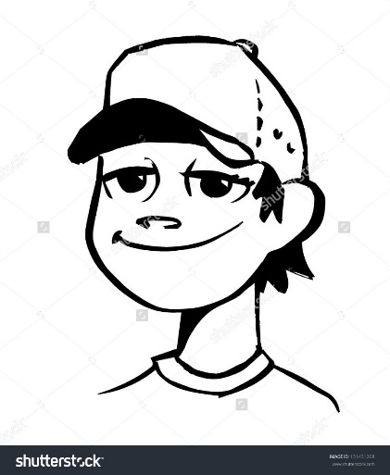
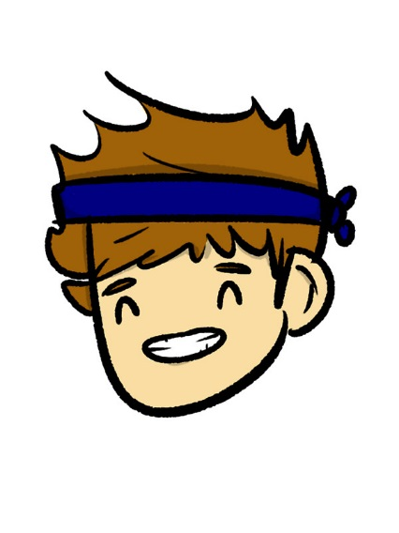
Dress Code
The following items are NOT allowed at A.O.D:
Hats
Caps
Bandanas
Shirts with suggestive or inappropriate
words or symbols

Slide 13
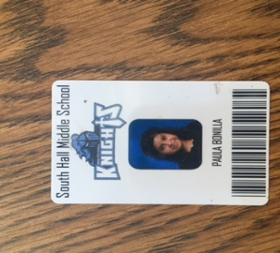
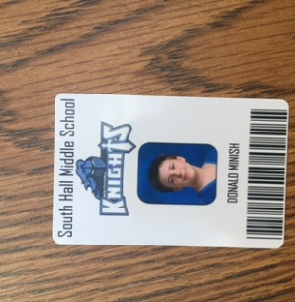
Badges
To increase efficiency with checking-in/out, breakfast and lunch transactions, and media center checkouts
DO… | DO NOT…
Keep badge clean and visible | Alter the badge (no drawing, adding a different picture, etc.)
Keep badge in book bag or purse when not wearing | Lose it! If you do: $5 cash replacement cost within 3 days of loss See procedure for replacement below****
Buy your own lanyard if you’d like (must be appropriate for school) | Lose privileges like not being able to attend dances or other special events, having to be at the back of your lunch line, etc. by losing your badge!

Slide 14

STUDENT AGENDAS
Communication Tool!
Students should write down all classroom and homework assignments from all classes in their agenda daily.
There is a strong correlation between writing assignments in the agenda (organization) and academic success.
The agenda is school property until the end of the last day of school. Students should not remove any pages from the agenda.

Slide 15

Ways to Promote Success
Check Planner / Agenda.
Set time for homework/reading.
Provide quiet place to study.
Make contact with teachers.
Utilize Infinite Campus/Canvas.
Be Involved.
Talk to your child about school.
Promote good attendance.
Know rules, expectations, and dress code.

Slide 16
Putting your worries to rest…
No lockers
Getting lost
Bullying
Interactions with 7th and 8th graders

Slide 17

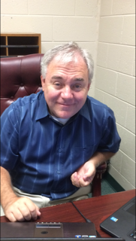
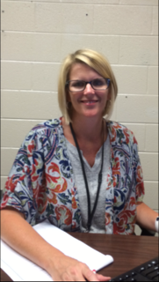
Problems?
See A Counselor
Dr. Philip Elrod
LeAnn Owens

Slide 18


Slide 19
A.O.D. Sports
(7th and 8th Grade)
Cross-country
Football
Cheerleading
Basketball
Wrestling
Track
Soccer
Baseball
Softball
Volleyball

Slide 20
Contact
Please visit the A.O.D at South Hall Web site
https://shms.hallco.org/
Teacher Sites / Paginas de Maestros
Call us: / Llámenoss: 770 532-4416
Email us at Firstname.Lastname@hallco.org
  Correo electrónico: primer nombre. apellido@hallco.org
  Leann.owens@hallco.org
  Philip.Elrod@hallco.org
  Renee.long@hallco.org
  https://aodshcnslr.weebly.com/
Sign Up for Remind
  Regístrese para Remind

Slide 21
Questions?

